Slide 1

Implementation of DSP Slice
CND111 – Course Project
Presented by Grp 10 – Section 14

Slide 2
Group Members
Name | ID
Rahma Aly Mahmoud Magdy Aly | V23010308
Mariz Gad Atta | V23009927
Mariz Sabry Zaky Attia | V23010580

Slide 3
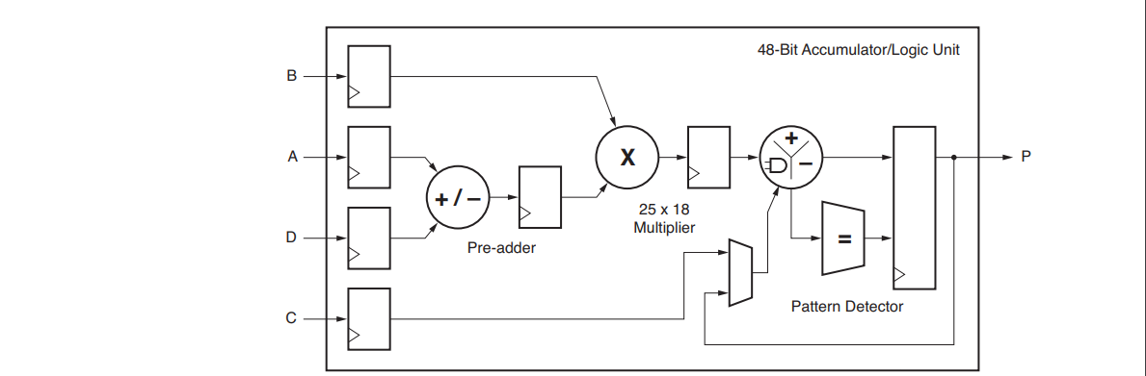
Introduction
Basic DSP Slice Components and Functionality
Applications
Implement various types of filters: low pass, high pass, band pass and adaptive filters.
Dynamic bus shifters, memory address generators, wide bus multiplexers, and memory-mapped I/O registers.

Slide 4
Introduction
Basic DSP Slice Components and Functionality
Applications
Implement various types of filters: low pass, high pass, band pass and adaptive filters.
Dynamic bus shifters, memory address generators, wide bus multiplexers, and memory-mapped I/O registers.

Slide 5
SYSTEM DESIGN/IMPLEMENTATION AND RTL SCHEMATIC

Slide 6
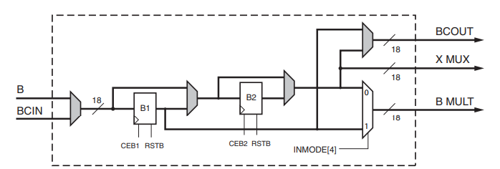
Dual Register B – DESIGN

Slide 7
Dual Register B – CONTROL SIGNALS AND ATTRIBUTES
 | BREG | BCASCREG | INMODE[4] | B_INPUT
Function | Sets the number of pipeline registers for input B | Sets the number of pipeline registers for output COUTB | Sets the value of BMULT | Selects the used input
Possible values | 0,1.2 | 0,1,2 | 0,1 | “Direct”, “Cascade”
Notes | BREG = 0, no pipelining. BREG = 1, register B2 is used. | Must be less than or equal to BREG. | 0: B2_MUX_OUT. 1: B1. | “Direct”: use input B. “Cascade”: use input BCIN

Slide 8
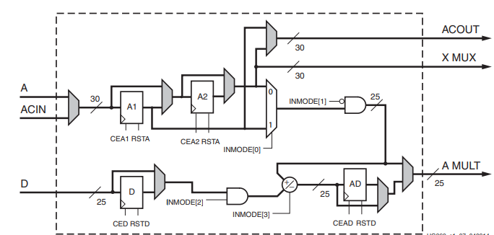
Pre adder and DUAL A, D – DESIGN

Slide 9
Pre adder AND DUAL A, D – CONTROL SIGNALS
INMODE[3] | INMODE[2] | INMODE[1] | AMULT
0 | 0 | 0 | A
0 | 0 | 1 | 0
0 | 1 | 0 | D + A
0 | 1 | 1 | D
1 | 0 | 0 | - A
1 | 0 | 1 | 0
1 | 1 | 0 | D – A
1 | 1 | 1 | D

Slide 10
Pre adder AND DUAL A, D – ATTRIBUTES
 | USEDPORT | ACASCREG | AREG/DREG/ADREG | A_INPUT
Function | Determines whether the pre-adder and the D Port are used or not. | Sets the number of pipeline registers for output COUTA | Sets the number of pipeline registers for input A/D/output of pre-adder AD | Selects the used input
Possible values | “TRUE”, “FALSE” | 0,1,2 | 0,1,2 | “Direct”, “Cascade”
Notes | If not used, the value of multiplier A port (AMULT) will either be zero or A (input) | Must be less than or equal to AREG. | 0: A2/D2 1: A1/D1/AD1 | “Direct”: use input A. “Cascade”: use input ACIN

Slide 11
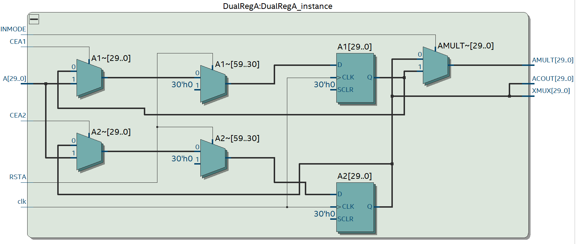
A DUAL REGISTER – schematic

Slide 12
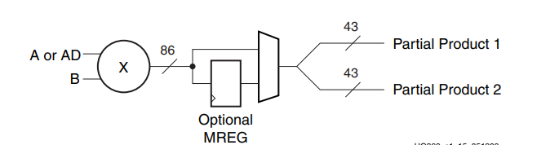
TWO’S COMPLEMENT MULTIPLIER – DESIGN
To get the 2 partial products, 2 multiplication operations are needed:
18 bits by 18 bits
25 bits by 18 bits

Slide 13
TWO’S COMPLEMENT MULTIPLIER – ATTRIBUTES
Attributes | Description | Settings | Importance
USEMULT | Selects usage of the multiplier. | MULTIPLY (Default), NONE | Saving power when the first stage multiplier is not being used (multiplier is bypassed). To save the 48-bit 2’s complement operands.
MREG | Selects the number of M pipeline registers that are enabled by CEM and reset synchronously by RSTM. | 0, 1(Default) | Using the register provides increased performance with an increase of one clock latency and it saves power.

Slide 14
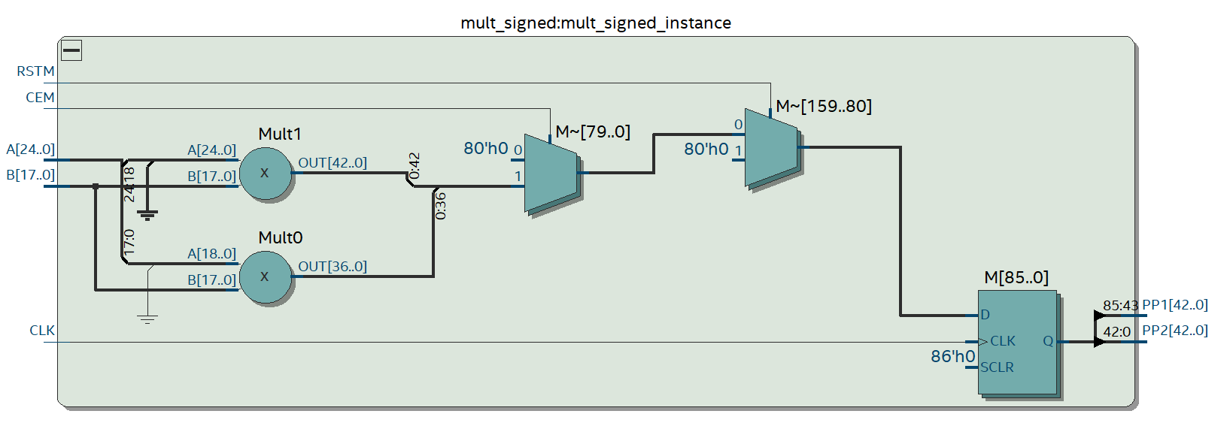
TWO’S COMPLEMENT MULTIPLIER – schematic

Slide 15
Carry in & MULTIPLIXERS
The multiplixers determines the inputs to the ALU unit controlled by the signal OPMODE (selection line to X,Y and Z multiplixers).
The Carry in to the ALU is controlled by 3-bit CARRYINSEL multiplixer. It can be cascaded.

Slide 16
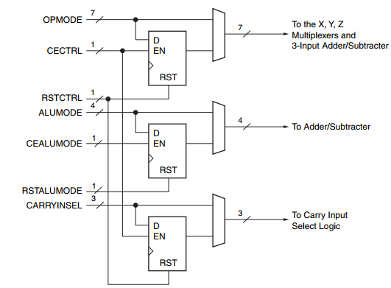
ALU UNIT – Control signals
The OPMODE, ALUMODE, and CARRYINSEL signals together determine the functionality of the embedded adder/subtracter/logic unit.

Slide 17
alu UNIT – operations
3-input Arthimetic operations: - Controlled by ALUMODE to add or subtract the inputs.
2-input Logic operations: - Controlled by ALUMODE and OPMODE[3:2]. - Performs logical bitwise operations: AND, OR, XOR, NAND, NOR and XNOR. - Performed on the inputs or the complement of the inputs.

Slide 18
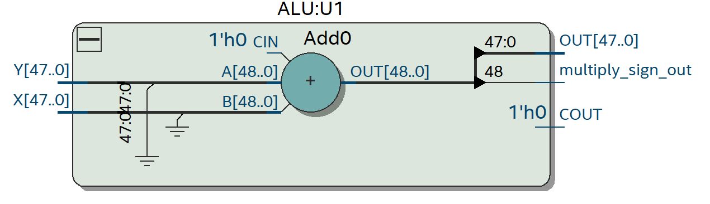
alu UNIT – Multiplication
When the ALU is used to get the result of the multiplier, USEMULT attribute is set to “MULTIPLY”, the selection line of the multiplixers passes the 2 partial products and the ALU becomes 2 input adder.

Slide 19
Pattern detector
A pattern detector detects if the output P matches a specified pattern or the complement of the pattern.
Pattern Detector Flags: PATTERNDETECT (PD), PATTERNBDETECT (PBD), UNDERFLOW, OVERFLOW.
A mask field can also be used to hide certain bit locations in the pattern detector.
The pattern and the mask fields can each come from an attribute called PATTERN and MASK respectively or from the (registered) C input.

Slide 20
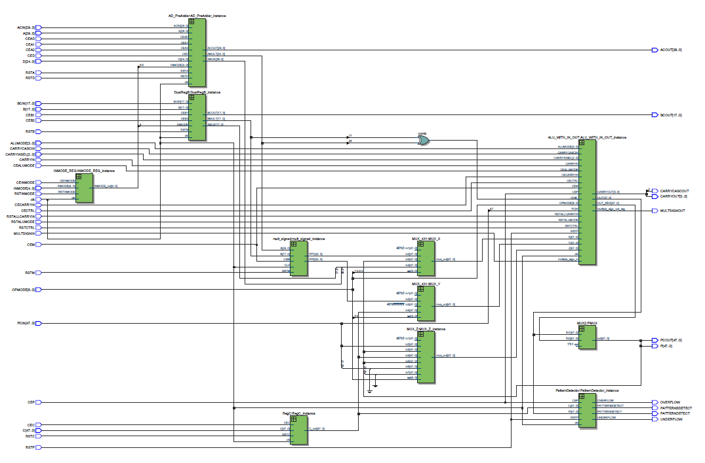
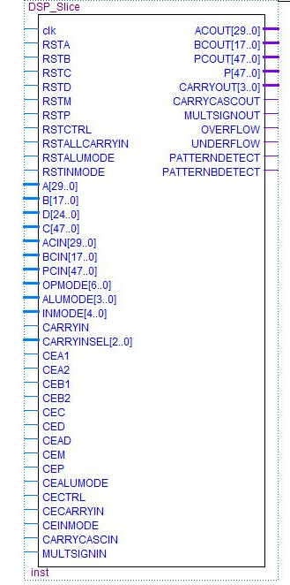
FULL SYSTEM SCHEMATIC AND SYMBOL

Slide 21
VERIFICATION

Slide 22
Verification – TEST plan
Testing Multiplication Operation: USEMULT is set to “MULTIPLY”, the multiplier is used and the ALU becomes 2-input adder. INMODE is controlled to test all the corresponding cases (17 test cases). A, B and D are randomized.
Testing ALU Operations: USEMULT is set to “NONE”, the multiplier is not used and the ALU is used as Arthimetic/Logic unit. INMODE and ALUMODE are controlled to test all the corresponding cases (17 test cases). A, B and D are randomized.
Pattern Detector is tested in both plans.

Slide 23
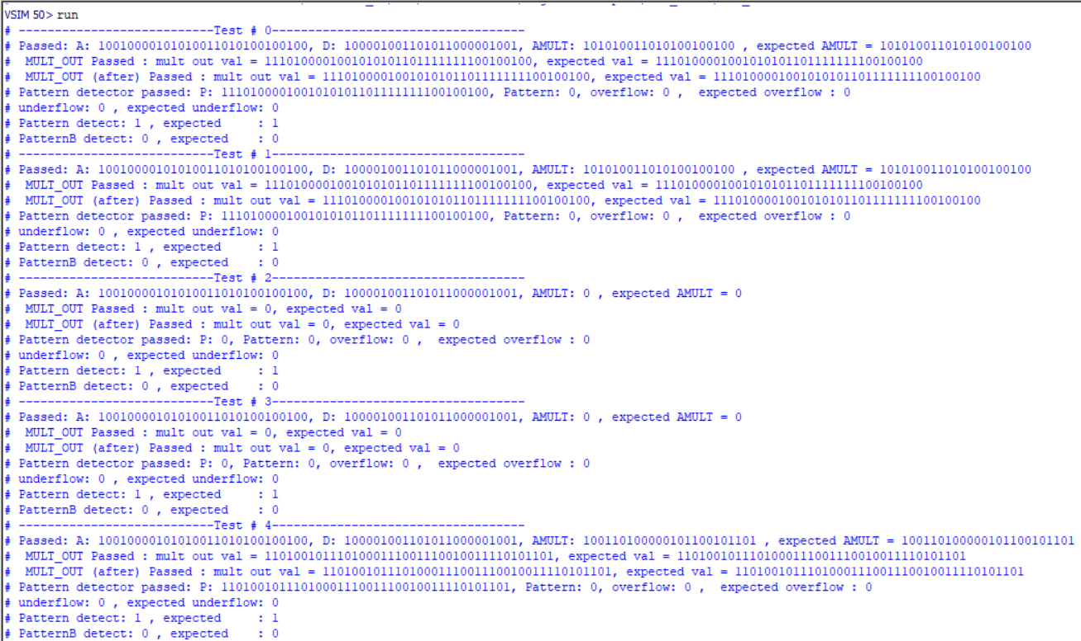
TEST CASES PASSED

Slide 24
SYNTHESIS RESULTS

Slide 25
Results – RESOURCE USAGE
 | Multiplier used | Multiplier not used
Logic Utilization (ALM needed/total) | 189/56480 | 484/56480
ALM used for logic and registers | 72 | 75
ALM used for LUT logic | 86 | 409
ALM used for registers | 75 | 30
Combinational ALUT usage for logic | 288 | 836
Dedicated logic registers | 299 | 215
I/O pins | 417 | 417
Clock pins | 12
DSP Blocks | 2 | 0
Global clock | 1 | 1
Maximum fan-out | 301 | 215
Highest non-global fan-out | 79 | 107
Total fan-out | 2979 | 4800
Average fan-out | 2.01 | 2.52

Slide 26
Results – POWER
The amount of consumed power depended on whether the multiplier was used or not, where the power increased when it was used.
 | Multiplier used | Multiplier not used
Total thermal power dissipation | 437.92 mW | 375.17 mW
Core Dynamic thermal power dissipation | 8.07 mW | 0
Core static thermal power dissipation | 349.29 mW | 349 mW
I/O thermal power dissipation | 80.56 mW | 26.17 mW

Slide 27
Results – timing
The maximum clock frequency for the design varied depending on whether the multiplier was used or not.
The input clock period was constrained to 10 nsec
The design didn’t violate setup nor hold constraints for all operating conditions.
 | Multiplier used | Multiplier not used
Maximum clock frequency | 124.8 MHz | 110 MHz
Model | Fast Cold | Slow Cold
Setup slack | 5.922 | 0.922
Hold slack | 0.187 | 0.481
Model | Fast Hot | Slow Hot
Setup slack | 5.662 | 1.137
Hold slack | 0.199 | 0.481

Slide 28
Conclusion
DSP48E1 has wider functionality and unique features relative to prior generations.
DSP slices can perform complex mathematical operations
DSP48E1 slice provides reduced overall power consumption and increased maximum frequency.

